Slide 1

DATAXACT DATATHON
Predicting CO Concentration in the Air using Gas Sensor Data
TEAM - DATA PIRATES
TEAM MATES- SIDDHANT
YASHI
SUMANTH

Slide 2
The clarity of the documentation- Studying the dataset
In the dataset under consideration, there were initially five distinct files. Among these files, three of them shared a common row labeled as "295719," while the remaining two files contained identical rows labeled as "295881." Consequently, we merged the three files with the matching row label into a single dataset.
Upon examining the merged data, we discovered that out of the total 295881 rows present in the two aforementioned files, (295881- 295719= 162), 162 rows consisted entirely of null values. Subsequently, we proceeded to remove these 162 rows from the dataset. Following this data cleansing step, we combined all five files together, resulting in a comprehensive dataset.
The subsequent slide illustrates the composition and characteristics of each individual file within the dataset.

Slide 3
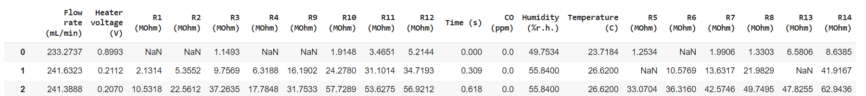
How our Dataset looks?
The data which we made by joining the 5 files is composed as:
Book1 - From this dataset we have included the column R5, R6, R7 and R8 and eliminated R13
and R14.
Book(i48) - From this dataset, all the columns are taken.
Book3 - From this dataset, all the columns are taken.
Book(i4) - From this dataset, all the columns are taken.
Book5 - From this dataset we have included the column R13 and R14, and eliminated Flow rate
and Heater Voltage.
Now our final dataset is one file which has these attributes:

Slide 4
Including code structure
Feature selection: Perform feature selection to identify the most relevant features that have the most significant impact on the CO concentration. This can be done using techniques like correlation analysis, feature importance from a machine learning model, or step-wise regression.
Train the model: Create an instance of the multiple linear regression model and train it on the training set using the fit() function.
Make predictions: Use the trained model to make predictions on the testing set using the predict() function.
Evaluate the model: Measure the performance of the model by comparing the predicted values with the actual values from the testing set. Calculate evaluation metrics such as mean squared error (MSE), root mean squared error (RMSE), mean absolute error (MAE), or R-squared.
Optimize the model (optional): If the model's performance is not satisfactory, consider feature selection techniques, feature engineering, or trying different algorithms to improve the results.
Use the model for predictions: Once satisfied with the model's performance, use it to make predictions on new, unseen data. Ensure that the new data goes through the same preprocessing steps as the training data (e.g., handling missing values, cleaning, feature transformation).
This algorithmic representation provides a general framework

Slide 5
Feature engineering techniques
For predicting the CO concentration in the air using gas sensor data with the intention of building a multiple linear regression model, you can consider the following feature engineering techniques:
Handling Missing Values: We can choose to impute missing values with mean, median, mode, or use advanced imputation techniques based on the characteristics of the dataset.
Feature Scaling: Normalize the numerical features (except the target variable i.e., CO(ppm) to ensure they have similar scales. This can be achieved through techniques such as min-max scaling or z-score standardization.
Interaction Features: Create interaction terms by multiplying or dividing relevant features. For example, you can consider creating interaction terms between humidity and temperature or between gas sensor resistances (R1 to R14).

Slide 6
Feature Selection: Use techniques like correlation analysis or statistical tests (e.g., p-value) to identify the most relevant features for the multiple linear regression model. Select features that have a strong linear relationship with the target variable.
Logarithmic Transformation: If the target variable (CO concentration) has a skewed distribution, consider applying a logarithmic transformation to normalize its distribution.
Feature Normalization: Normalize the target variable (CO concentration) if it has a skewed distribution using techniques like logarithmic transformation or Box-Cox transformation. This can help satisfy the assumptions of linear regression.
Outlier Detection: Identify and handle outliers in the dataset, as they can influence the model's performance. You can use techniques like Z-score or box plot analysis to detect and handle outliers appropriately (e.g., removing or transforming them).

Slide 7
Model Selection
Model selection is the process of choosing one among many candidate models for a predictive modeling problem.
There may be many competing concerns when performing model selection beyond model performance, such as complexity, maintainability, and available resources.
The two main classes of model selection techniques are probabilistic measures and resampling methods.
For our model since it is Supervised and values to be predicted are continuous data we are going with Multiple Linear Regression.
Multiple linear regression is a regression model that estimates the relationship between a quantitative dependent variable and two or more independent variables using a straight line

Slide 8
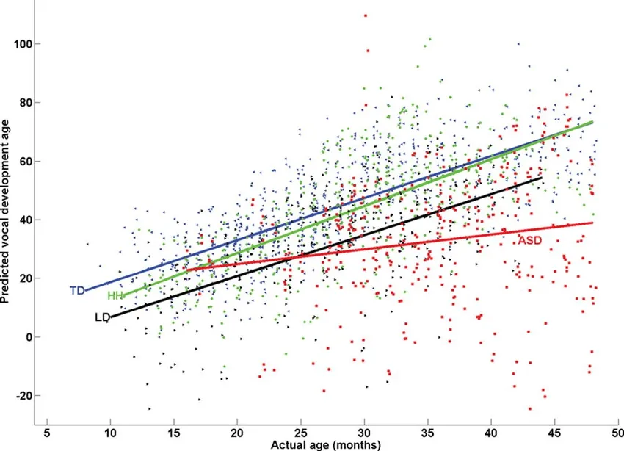
The dataset includes various independent variables such as Time (s), Humidity (%r.h.), Temperature (C), Flow rate (mL/min), Heater voltage (V), and multiple resistance values (R1 to R14). The output variable of interest is the CO concentration (ppm).
Prior to training the model, it is crucial to examine the relationship between the independent variables and the target variable. Visualizations can help identify any patterns or correlations between the independent variables and the CO concentration. This step aids in understanding the data and assists in making informed decisions during feature selection.

Slide 9
Evaluation Results
Splitting our data into training and test data.
We are going to train our model with train data set
We are going to predict the result for the test data set
And then we are going to calculate the accuracy and some matrices for the predicted data of the test data set.
Find MSE and RSME values.
Use R² score or adjusted R² score to evaluate your model's performance on the training data.
Evaluate the model's performance on the test data. If you see a large difference in performance this may be due to overfitting.
We can remove overfitting by adding some more data or changing the train data or test data
Thus we will evaluate our model.

Slide 10
Thank You

